Slide 1
Databases Summary

Slide 2
Agenda
What is a database?
Benefits of using database.
Types of databases.
DynamoDB.
Benefits of using DynamoDB.
Key concepts of DynamoDB.

Slide 3
Agenda
7. API.
8. Redshift.
9. Benefits of using redshift.
10. Amazon Aurora.
11. Benefits of using Amazon aurora.
12. ElastiCache.
13. Benefits of using ElastiCache.

Slide 4

Database
Collection of data,
  Organised systematically.
Store, change and retrieve our data easily.
Simplify data management.
Focus on application code and business growth.

Slide 5
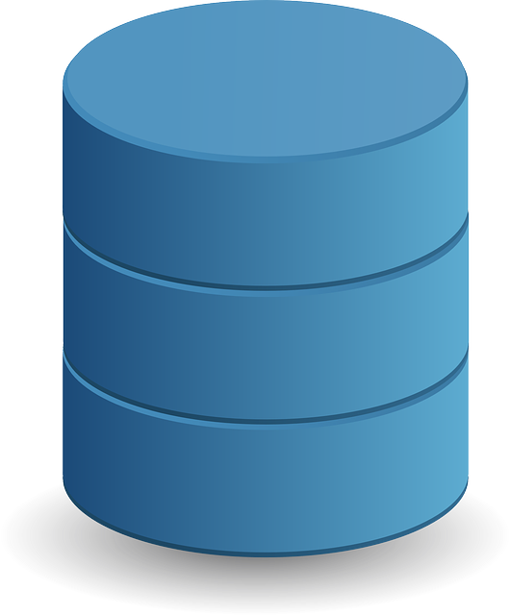
Benefits of Databases
Highly scalable.
Fully managed.
Functions are distributed.
Smooth and fast.
Pay for the resources.

Slide 6

Types of Databases
Relational Database.
NoSQL Database.
Centralized database.
Graph database.
Cloud database.

Slide 7

DynamoDB
Automated NoSQL database service provided by Amazon.
Don't have to write queries to create a table or retrieve data.
Fully managed.
Automatically handles data traffic.
Greatest possible performance.

Slide 8
Benefits of DynamoDB
We can scale them as per our needs.
Cross-region replication.
Access Control on a fine scale.
DynamoDB Streams.

Slide 9
DynamoDB Important Concepts
Tables:
Data is stored in the form of tables.
Collect data and group different items.
Items:
Tables contain items.
Group of attributes.
Want to store in our DynamoDB table.

Slide 10
DynamoDB Important Concepts
Attributes:
Made up of one or more attributes.
Basic data element.
Cannot be broken down further.

Slide 11
DynamoDB Important Concepts
Primary key:
Uniquely identifies each item in a table,
  Different items have different keys.
Two types of primary keys:
Partition key.
Partition key and sort key.

Slide 12
DynamoDB Important Concepts
Query the data in database using an alternate key.
More flexibility.
DynamoDB streams record data update events.
In near-real time.
Each event is represented by a stream record.
Stream records are recorded for 24 hours.

Slide 13
DynamoDB Modes
On-Demand mode:
Make new tables with a variety of workloads.
Dealing with unpredictably high application traffic.
Convenience of simply paying.

Slide 14
DynamoDB Modes
Provisioned mode:
We have a predictable application traffic.
We operate applications with a steady stream of traffic or one that progressively rises.
To keep expenses under control, we can forecast capacity requirements.

Slide 15

API
API stands for
  Application programming interface.
Allows two apps to connect to access data.

Slide 16

Redshift
Managed, petabyte-scale cloud data warehousing service.
Store and analyse all of our data.
Good mix of ease of setup.
Maintenance and a wide range of customization options.

Slide 17
Benefits of Redshift
Security
Easy to manage.
Scalable.

Slide 18

Amazon Aurora
Relational database for cloud
  Supports MySQL and PostgreSQL.
Speed and availability,
  Simplicity and cost-effectiveness.
Hardware provisioning, database setup, patching, and backups.

Slide 19
Advantages of Aurora
Scalability and high performance.
High availability and durability.
Highly secure.
Fully managed.

Slide 20

ElastiCache
Easy to set up.
Run.
Scale popular open-source in-memory data storage.

Slide 21
ElastiCache
By obtaining data from high throughput
Low latency in-memory data stores.
Data-intensive apps or improve the performance.
Send it considerably more quickly if it is cached.

Slide 22
Advantages of ElastiCache
Exceptional performance.
Fully managed.
Scaling.

